Slide 1
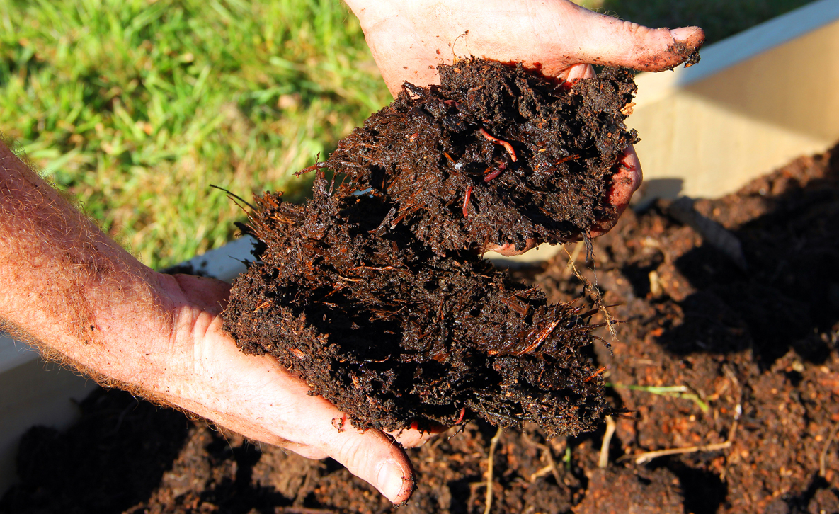
Notes:
[“Organic farms were found to have 26 percent more long-term carbon storage potential than conventional farms.” QUOTE AND PHOTO: https://civileats.com/2017/09/11/new-study-shows-organic-farming-traps-carbon-in-soil-to-combat-climate-change/]

Slide 2
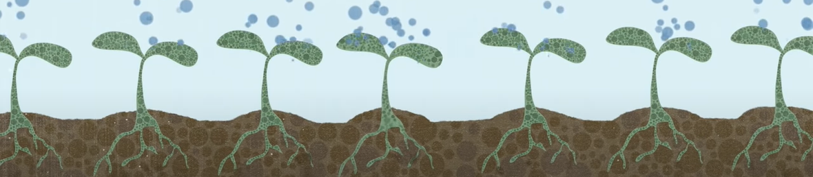
THE 2020 GROWING CLIMATE SOLUTIONS ACT (GCSA)
REDUCING BARRIERS TO ENTRY
TO PRIVATE CARBON MARKETS
Notes:
[IMAGE: The Soil Story narrated by Larry Kopald from https://www.youtube.com/watch?v=08TI1RKj54g]
The costs that the GCSA is designed to reduce for farmers and foresters are associated with understanding the (upcoming) carbon markets, participating in those markets via USDA-certified third party carbon credit sellers, and, carbon credit market updates and maintenance.

Slide 3
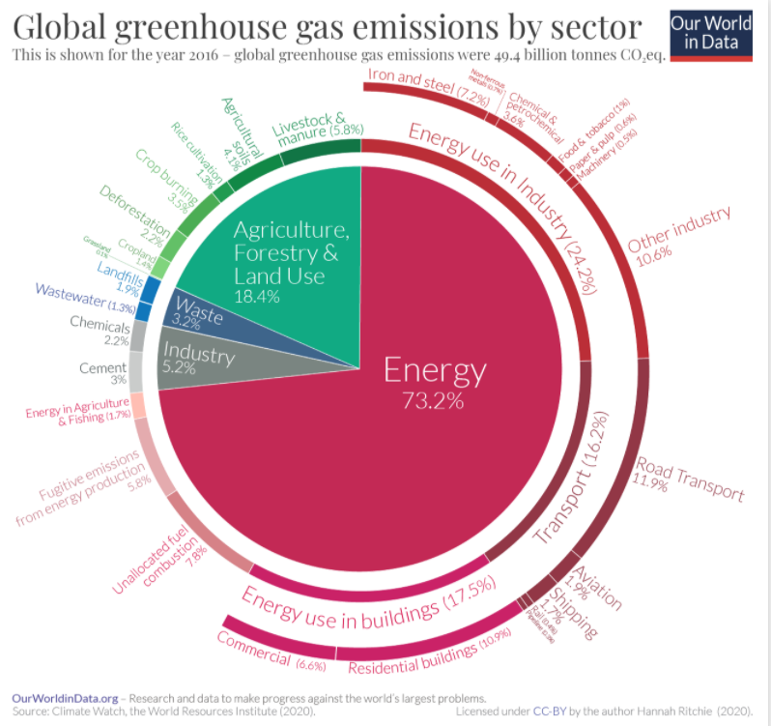
Globally, agriculture and forestry together account for ~18% of greenhouse gas emissions.
Notes:
[GRAPHIC: https://ourworldindata.org/emissions-by-sector]
Approximately two-thirds of the total increase in atmospheric CO₂ is a result of the burning of fossil fuels, with the remainder coming from SOC loss due to land use change (Lal 2004), such as the clearing of forests and the cultivation of land for food production. https://www.nature.com/scitable/knowledge/library/soil-carbon-storage-84223790/#:~:text=Current%20estimates%20are%20that%20carbon,about%203%20GT%20C%2Fyr.

Slide 4
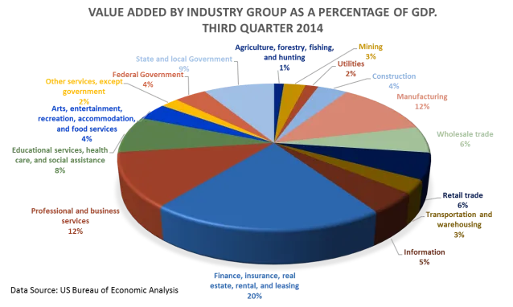
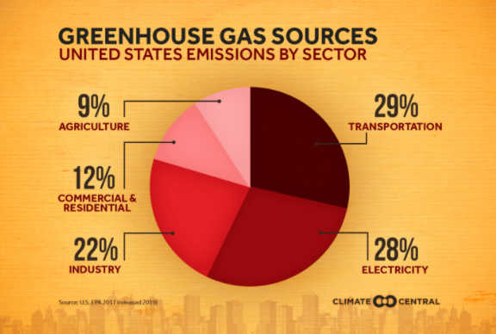
Agriculture accounts for ~1% of US GDP and ~9% of national greenhouse gas emissions
Notes:
[LEFT GRAPHIC: https://www.climatecentral.org/gallery/graphics/emissions-sources-2020 and
RIGHT GRAPHIC: https://econometricus.com/2015/01/22/real-us-gdp-third-quarter-2014/]

Slide 5
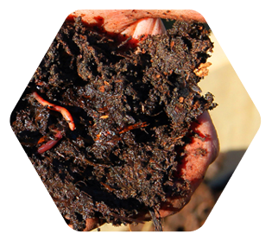
AGRICULTURAL MANAGEMENT OF CARBON POLLUTION
WITHOUT GOVERNMENT INTERVENTION:
No valuation
High conversion costs
Agriculture relatively “innocent” (of the CO₂ thing)
Is it fair, or, equitable that farmers/foresters own the burden of conversion costs for carbon sequestration in order to mitigate (national levels of) pollution?

Slide 6
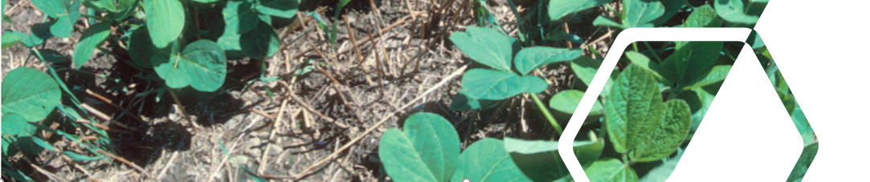
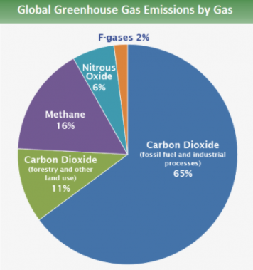
Carbon Farming = “Critical Climate Solution”
CARBON SINKS = reservoirs that retain carbon and keep it from entering the Earth’s atmosphere
Biomass
Soils
Soil carbon measurements are:
Better established
Easier to track and trace
Can be more readily controlled
Notes:
[GRAPHIC: https://www.epa.gov/ghgemissions/global-greenhouse-gas-emissions-data]
The goal of increased storage of carbon in soil has received much wider acceptance due to a better understanding of the processes involved in SOC storage, more direct control of these processes through human activities, and the other known ecosystem benefits to be obtained by increasing SOC, including benefits to water quality and increased food security. https://www.nature.com/scitable/knowledge/library/soil-carbon-storage-84223790/

Slide 7
Questions farmers and foresters may have:
What is carbon farming?
How do I get certified for carbon credit (production)?
Which sequestration method should I employ first?
How much carbon sequestration is one carbon credit worth?
Who will certify me for participation in the carbon market?
How do I measure the amount of carbon being sequestered by the practices I implement?
Do my existing agricultural practices qualify for carbon trading?
What’s in it for me and/or what will this cost me?

Slide 8
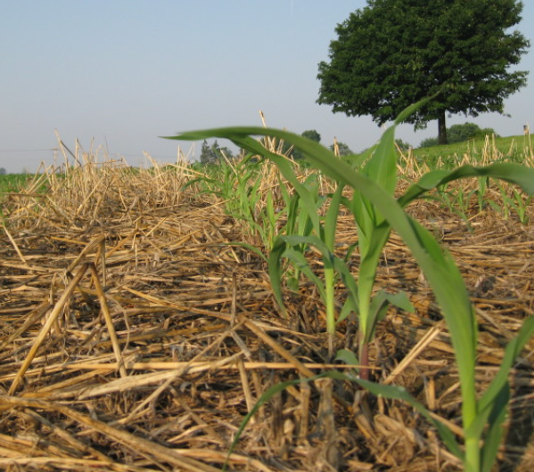
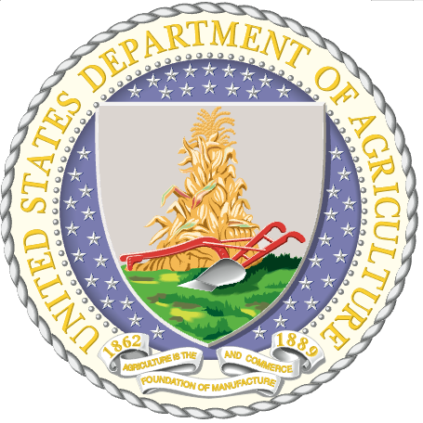
The GCSA and the US Secretary of Agriculture aim to help with the costs of:
Understanding carbon markets.
Participating via certified 3rd party carbon credit sellers.
Updating and maintaining carbon credit markets.
If costs are subsidized, carbon sequestration will increase.
Notes:
[PHOTO: https://regenerationinternational.org/farmers-are-capitalizing-on-carbon-sequestration]

Slide 9
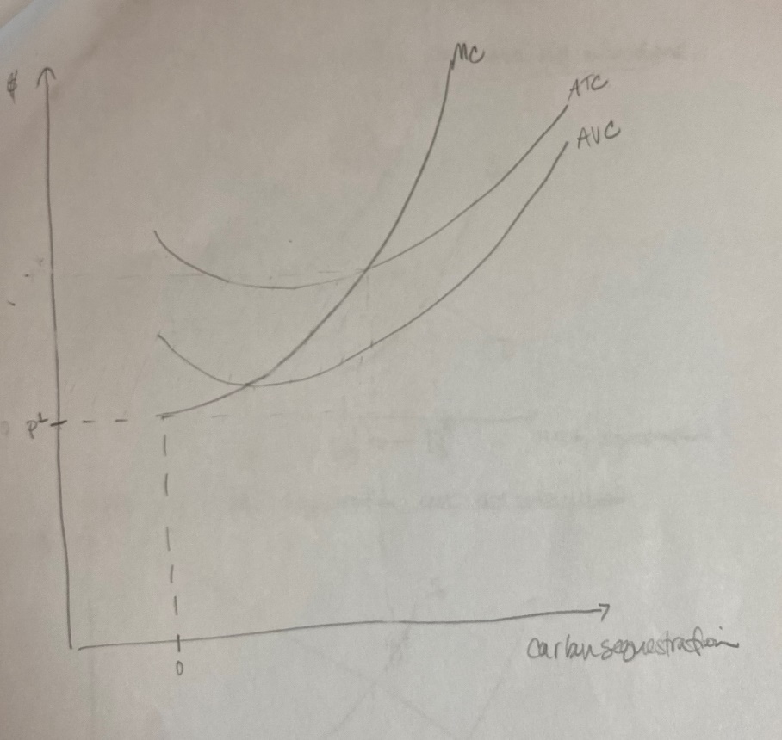
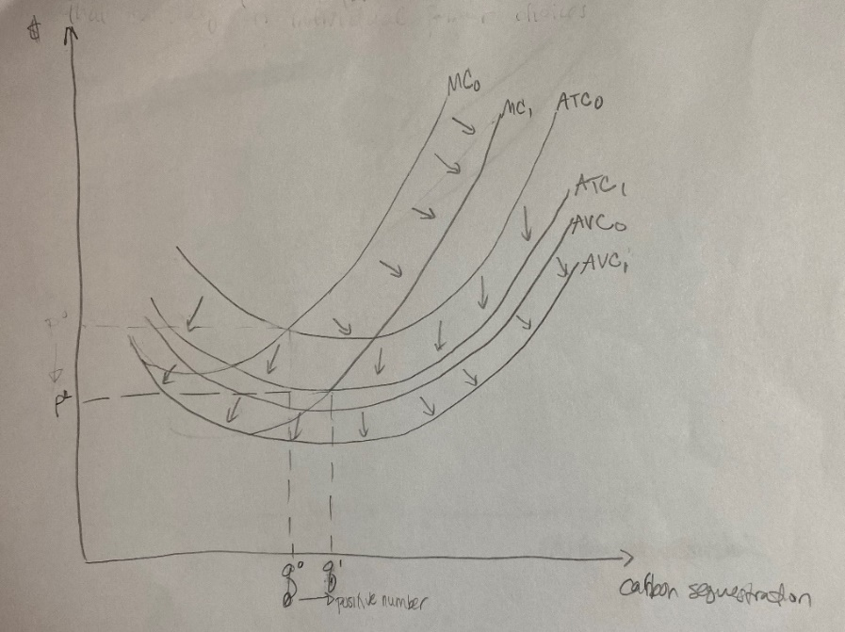
Uncertainty ● Costs of Learning ● Network Effects

Slide 10
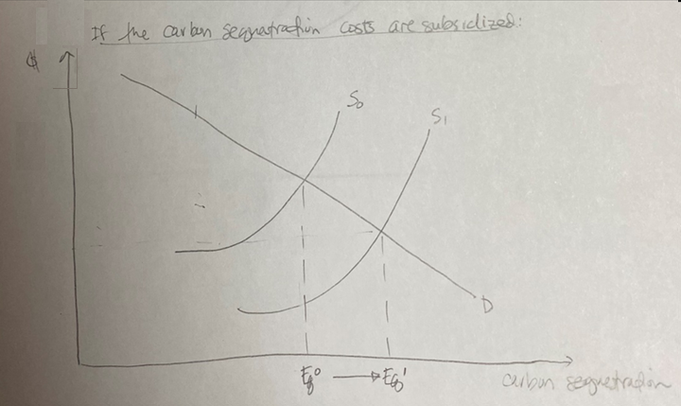

Slide 11
We can think of the subsidization effect of the GCSA like a positive externality.
Added to the marginal private benefit of carbon sequestration, this positive externality helps to produce the marginal social benefit curve.
Assuming that this market is working effectively, and that Pareto improving opportunities continue to be taken—until the Pareto optimum has been reached—then the net social benefits have also continuously improved with the growth of the market. We head towards social optimal.

Slide 12
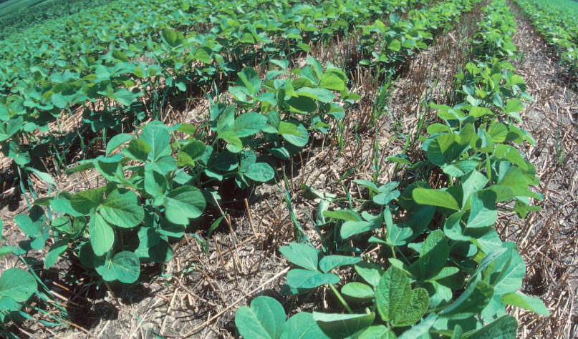
FORESTRY:
-afforestation
-reforestation
-forest preservation
AGRICULTURE:
-revegetation
-more efficient fertilizer employment
-cover crops
-tillage practices that minimize erosion
-organic matter in topsoil
Notes:
Young soybean plants thrive in the residue of a wheat crop. This form of no till farming provides good protection for the soil from erosion and helps retain moisture for the new crop. Photo credit: USDA NRCS Photo Gallery
[PHOTO: https://regenerationinternational.org/2018/06/24/no-till-farming/]
[INFO: https://www.britannica.com/technology/carbon-sequestration#ref282923]

Slide 13
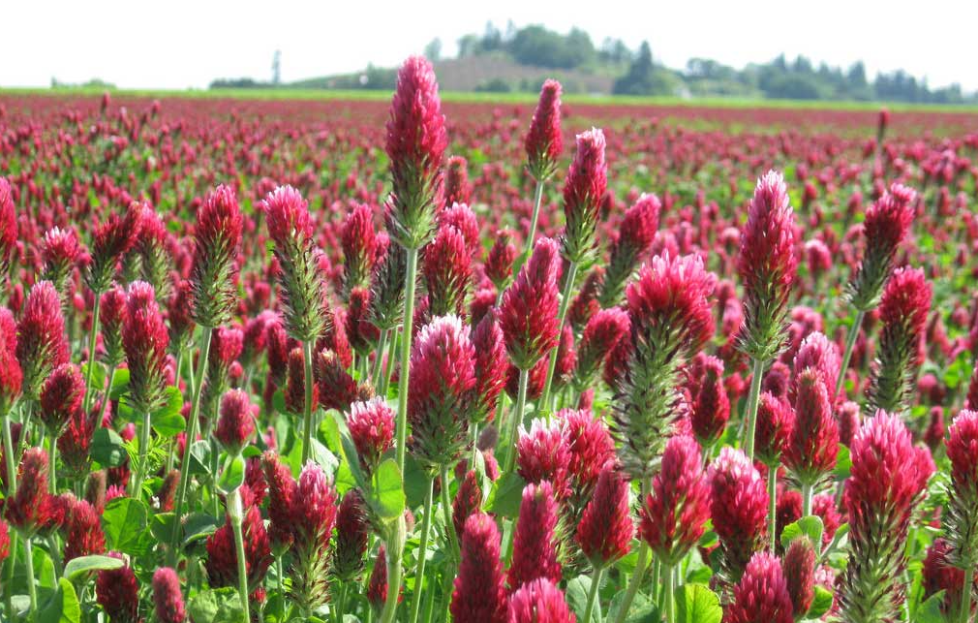
CALIFORNIA
The 10 states of the RGGI, or Regional greenhouse gas initiative: Connecticut, Delaware, Maine, Maryland, Massachusetts, New Hampshire, New Jersey, New York, Rhode Island & Vermont
The goal of efforts in California (which has an established carbon trading market) is not just capturing and storing carbon, but also creating more productive or sustainable agricultural soils.
Notes:
[PHOTO: https://today.oregonstate.edu/news/instead-leaving-soil-naked-coat-it-cover-crops]
[INFO: https://www.technologyreview.com/2019/06/21/65661/carbon-farming-is-the-hot-and-overhyped-tool-to-fight-climate-change/]
-Most farm-related emissions come in the form of methane (CH4) and nitrous oxide (N2O). Cattle belching (CH4) and the addition of natural or synthetic fertilizers and wastes to soils (N2O) represent the largest sources, making up 65 percent of agricultural emissions globally. https://www.wri.org/blog/2014/05/everything-you-need-know-about-agricultural-emissions
-Production efficiencies have already led to agricultural decreases in emissions.
https://www.fb.org/market-intel/agriculture-and-greenhouse-gas-emissions#:~:text=Greenhouse%20gas%20emissions%20related%20to,percent%20from%20a%20decade%20ago.
-” The earth's biosphere constitutes a carbon sink that absorbs approximately 2.3 GtC annually. This represents nearly 30 percent of all fossil fuel emissions (totaling from 6.3 to 6.5 GtC/year) and is comparable to the CO₂emissions resulting from deforestation (1.6 and 2 GtC/year).” http://www.fao.org/3/ac836e/AC836E03.htm#:~:text=The%20earth's%20biosphere%20constitutes%20a,and%202%20GtC%2Fyear).
-” Despite the much larger size of the oceanic carbon pool relative to the soil carbon pool, the rate of exchange between the atmosphere and the soil is estimated to be higher than that between the atmosphere and the ocean. Current estimates are that carbon inputs from photosynthesis by terrestrial vegetation fixes more carbon than carbon loss through soil respiration, resulting in a soil storage rate of about 3 GT C/yr. Oceanic carbon flux rates suggest oceans store about 2 GT carbon/yr despite occupying a vastly larger proportion of the earth's surface
Since the industrial revolution, the conversion of natural ecosystems to agricultural use has resulted in the depletion of SOC levels, releasing 50 to 100 GT of carbon from soil into the atmosphere (Lal 2009). This is the combined result of reductions in the amount of plant roots and residues returned to the soil, increased decomposition from soil tillage, and increased soil erosion (Lemus & Lal 2005). Depletion of SOC stocks has created a soil carbon deficit that represents an opportunity to store carbon in soil through a variety of land management approaches. However, various factors impact potential soil carbon change in the future, including climatic controls, historic land use patterns, current land management strategies, and topographic heterogeneity.” https://www.nature.com/scitable/knowledge/library/soil-carbon-storage-84223790/#:~:text=Current%20estimates%20are%20that%20carbon,about%203%20GT%20C%2Fyr.

Slide 14
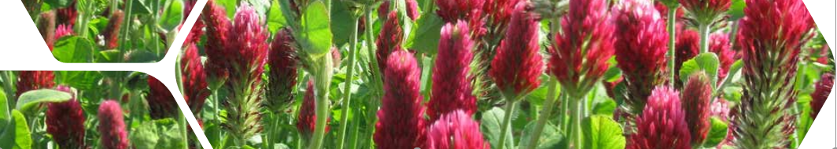
CARBON MARKET DESIGN IMPLICATIONS
3RD party certifiers may:
Allow for better risk management
Increase efficiency
Require regulation to prevent systematic abuse

Slide 15
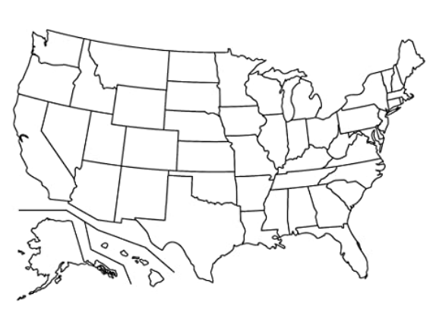
Previously successful emissions trading systems in the US:
Sulfur dioxide
Nitrogen oxides
Volatile organic compounds

Slide 16
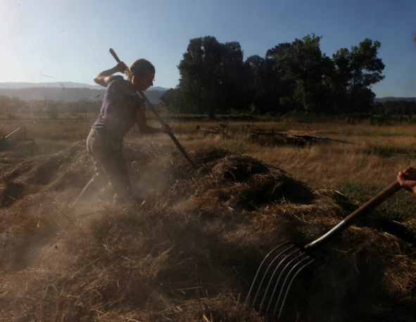
While non-measured and non-certified methods of carbon sequestration may exist, and while non carbon-market participants may already be doing their part, having a system of measurement and giving value to the sequestration itself will increase sequestration, as long as there is government subsidization (of the costs of uncertainty).
Notes:
[PHOTO: https://www.hcn.org/issues/51.9/climate-change-the-case-for-carbon-farming-in-California]

Slide 17
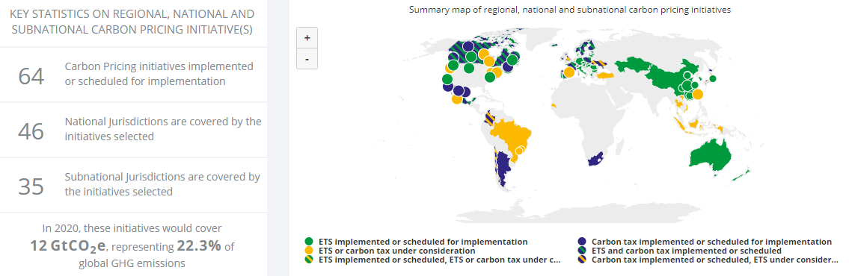
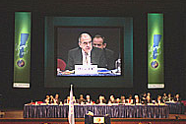
UNFCCC COP6, KYOTO PROTOCOL, 2000
Notes:
https://carbonpricingdashboard.worldbank.org/

